Slide 1
Lecture 11: Placement – I
Tsung-Wei (TW) Huang
Department of Electrical and Computer Engineering
University of Utah, Salt Lake City, UT

Slide 2
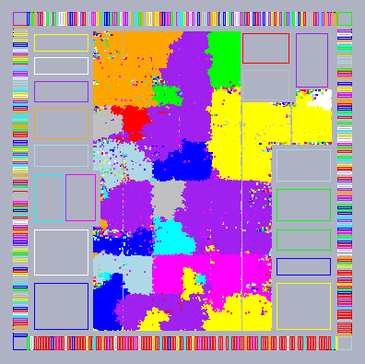
Physical Design Flow

Slide 3
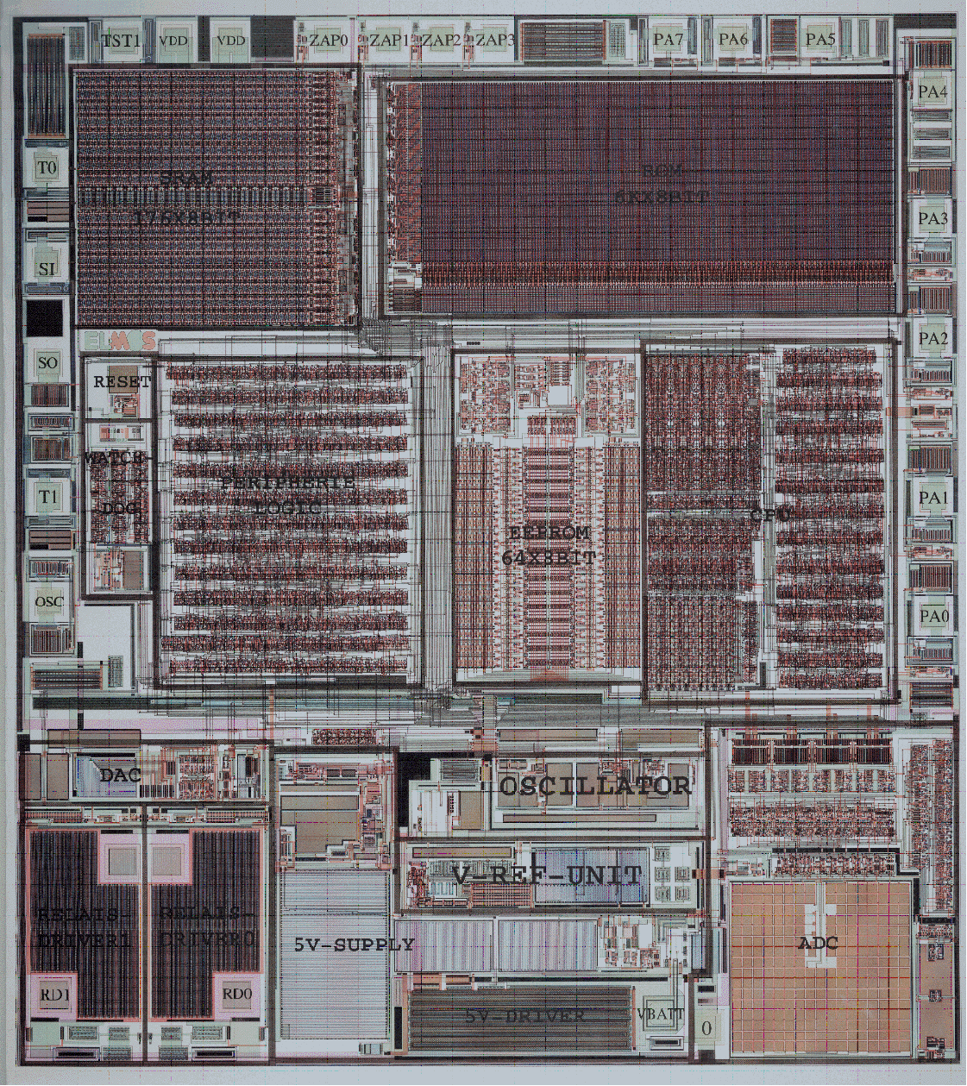
Placement
Places a netlist of gates and wires in a chip
Min wirelength
Min area
Min power
Min delay
…

Slide 4
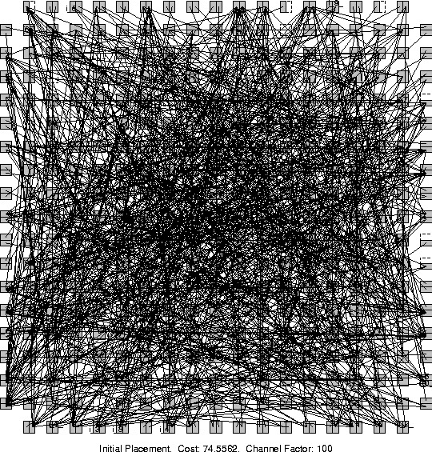
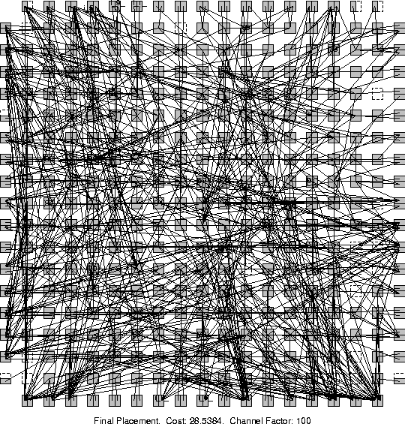
Example
Which placement result is better?

Slide 5
Placement Problem
What does a placer do?
Input: Netlist of gates & nets
Output: Exact location of each gate
Goal: Able to route (connect) all wires
Placement is VERY HARD!
Bad placement → Much more wire
More wire: bigger, slower chip
If placement is very bad, next tool in the flow—the router—unable to connect all wires, or meet timing

Slide 6
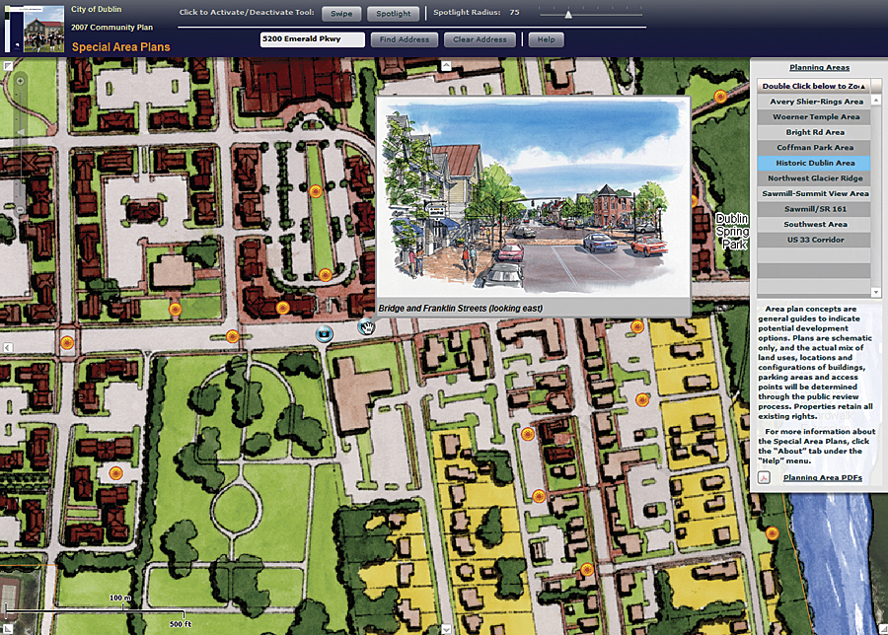
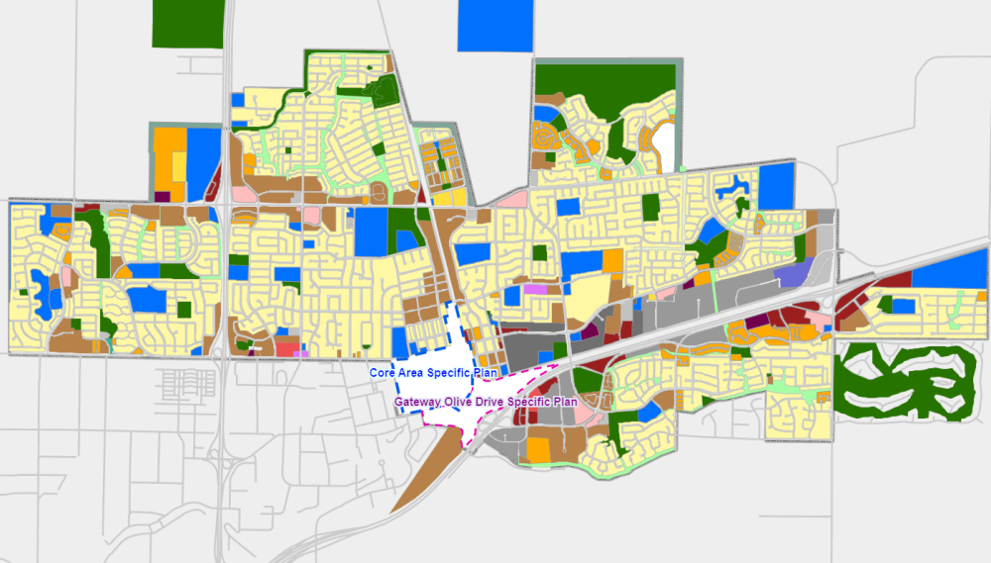
Analogy to City Planning
How to plan a city for 5-10M+ people?

Slide 7
Requirement for Placement
Must handle 4-10M cells, 1000s macros
64 bits + near-linear asymptotic complexity
Accept fixed ports/pads/pins + fixed cells
Place macros, esp. with var. aspect ratios
Non-trivial heights and widths (ex: height=2rows)
Honor targets and limits for net length
Respect floorplan constraints
Handle a wide range of placement densities
From <25% to 100% occupied

Slide 8
Requirement for Placement (cont’d)
Add / delete filler cells and Nwell contacts
Ignore clock connections
ECO (Engineering Change Order) placement
Fix overlaps after logic restructuring
Place a small number of unplaced blocks
Datapath planning services
Ex: many-core processor units
Provide dialog services to enable cooperation across tools
Ex: between placement and synthesis

Slide 9
Importance of Placement
Placement is a fundamental problem for physical design
Becomes very active again in recent years:
Many new academic placers since 2000
Many other publications to handle timing, routability, etc.
Reasons:
Serious interconnect issues (delay, routability, etc.) in advanced nodes
Placement determines interconnect to the first order
Need placement information even in early design stages (ex: logic synthesis)
Placement problem becomes significantly larger
Cong et al. [ASPDAC-03, ISPD-03, ICCAD-03] point out that existing placers are far from optimal, not scalable, and not stable

Slide 10



Industry-Academia Collaboration

Slide 11
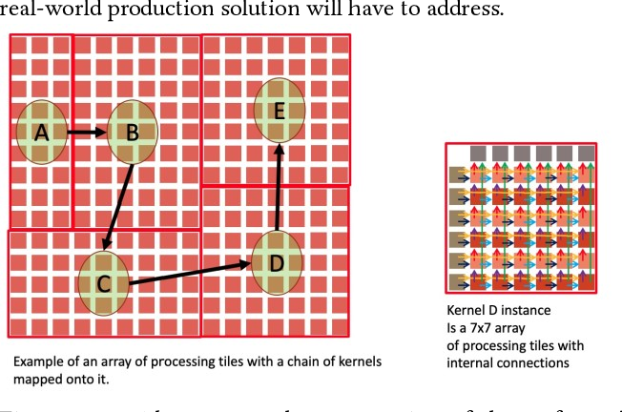
Placement for Different Design Styles
Standard cell placement (main focus of this course!)
Gate array / FPGA placement
Macro block placement
Typically called floorplanning
Mixed-size placement
A few large macro blocks
A large number of small cells
Wafer-scale placement
Thousands of processor units
Wafer-scale placement:
https://github.com/Cerebras/ispd2021

Slide 12
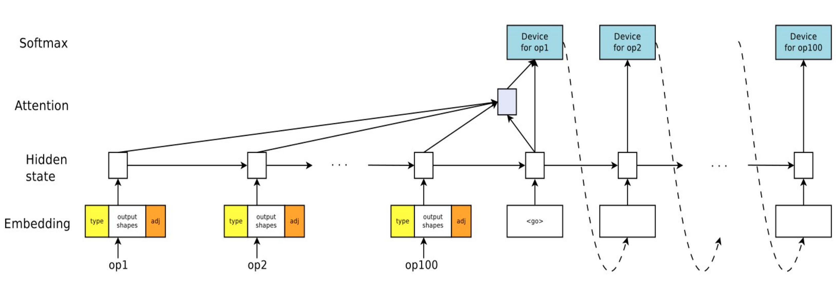
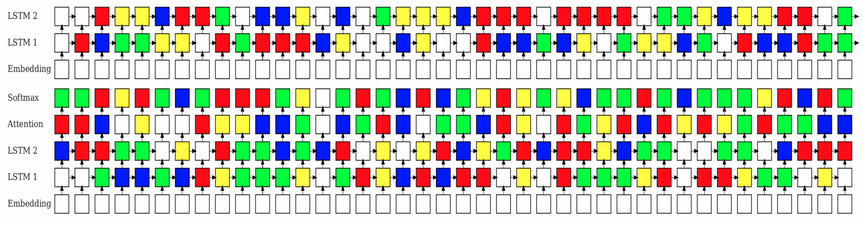
Placement in Machine Learning
GPU device placement optimization for neural networks
Place each tensor operator onto a GPU for improved performance
https://arxiv.org/abs/1706.04972

Slide 13
Placement Footprints
Standard Cell
Data Path
IP - Floorplanning

Slide 14
Placement Footprints (cont’d)
Reserved areas
Mixed data path & sea of gates
Core
IO
Control

Slide 15
Placement Footprints
Perimeter IO
Area IO

Slide 16
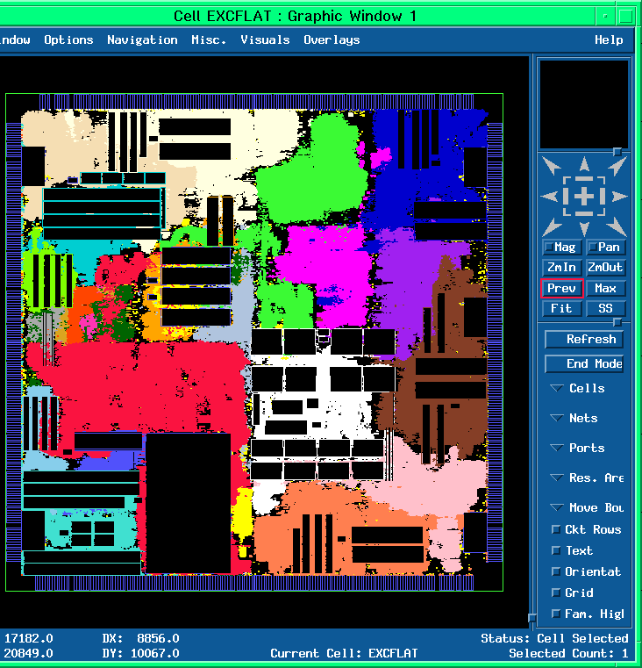
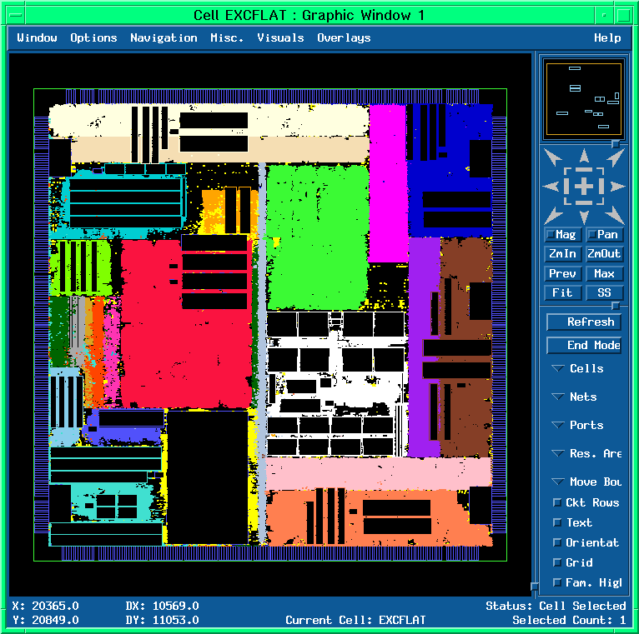
Commercial Tools

Slide 17
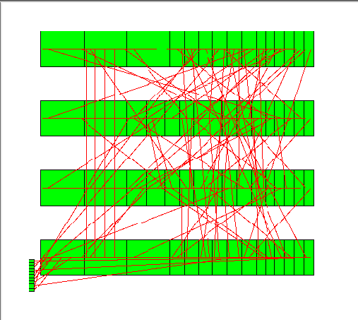
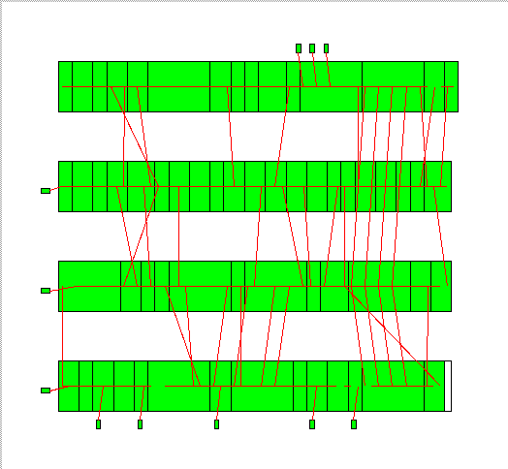
Placement is VERY HARD
Even this simplified placement problem is NP-complete
1D placement
2-pin nets only
All modules are of the same size
Wirelength as the only cost function
Realistic placement problems are
2D placement
Multi-pin nets
Modules of different sizes
Various cost function in addition to total wirelength
Various constraints for different target applications
bad placement
good placement

Slide 18
Let’s Start with a Simple Placer
Very simple model of the chip
A simple grid – like a chess board
Cells (gates) go in grid slots
Pins (connect off-chip, fixed at edges)
Very simple model of gates
All gates are exactly the same size.
(Unrealistic, but simplifies things)
Each grid slot can hold 1 gate
Any gate can go in any slot

Slide 19
Objective of a Placer
Placer optimizes the ability of router to connect all the nets
But routers are computationally expensive tools. We can’t run one “inside” placer
We need a simplified approximation at this stage
Every real placer minimizes expected wirelength
For each wire in the design, estimate the expected length of the routed wire
Minimize this objective: ∑_{wires Wi} EstimatedLength(Wi)
Placer finds gate locations to minimize this objective

Slide 20
Placement Terminology
Common term for a wire in a layout is called Net
The whole set of gates and wires is called netlist
Net categorized by how many things it connects.
A “2-point net”
A “4-point net”
y=5
4
3
2
1
0
y=5
4
3
2
1
0
x= 0 1 2 3 4
x= 0 1 2 3 4

Slide 21
Wirelength Estimation
Many different estimators for different placer methods
Multi-point nets can be routed in many different paths
In a dense layout, nets do not all get routed in a “shortest path”
y=5
4
3
2
1
0
y=5
4
3
2
1
0
y=5
4
3
2
1
0
x=0 1 2 3 4
x=0 1 2 3 4
x= 0 1 2 3 4

Slide 22
Half-perimeter Wirelength (HPWL)
Most placers adopt Half-Perimeter Wirelength (HPWL)
Also know as Bounding Box (BBOX) wirelength
Put smallest “bounding” box around all gates
Assume gate lives in “center” of the grid slot
Add width (∆X) and height (∆Y) of the BBOX for the wirelength estimate
A “2-point net”
A “4-point net”
y=5
4
3
2
1
0
y=5
4
3
2
1
0
∆X=3-1=2; ∆Y=4-1=3. HPWL=5
∆X=4-1=3; ∆Y=5-1=4. HPWL=7
x=0 1 2 3 4
x=0 1 2 3 4

Slide 23
About HPWL
Easy to calculate, even for a multi-point net:
[max{X coordinates of all gates) – min{X coordinates of all gates}] + [max{Y coordinates of all gates) – min{Y coordinates of all gates}]
Always a lower bound on the real wire length
No matter how complex the final routed wire path is…
…you need at least this much wire to connect everything
Aside: all wiring on big chips (and most boards) is strictly horizontal & vertical – no “arbitrary angles” for manufacturing reasons which is another reason HPWL is good

Slide 24
About HPWL (cont’d)
Real distribution of HPWL for 200K gate IBM ASIC [DAC97]
181K nets. Note LOG scale. Most nets are short. But there is a long tail to distribution.
Number of nets
HPWL

Slide 25
A Simple Iterative Placer
Start with a random placement
Just randomly assign each gate to a grid location (1 gate per entry)
Yes – this is a terrible placement. Really big L = ∑_{nets Ni} HPWL(Ni)
Random iterative improvement
Pick a random pair of gates in the grid and swap their locations
Evaluate the change in
L = ∑_{nets Ni} HPWL(Ni);
ΔL= [new HPWL – old HPWL]
If ΔL<0, new L got smaller → Improvement! Keep this swap
If ΔL>0, new L got bigger → Worse! Undo this swap
Keep doing this for many, many random swaps, until L stops improving

Slide 26
A Simple Iterative Placer: Pseudocode
foreach( gate Gi in netlist ) //random initial placement
place Gi in random location (x,y) in grid not already occupied
L=0 //calculate initial HPWL wirelength for whole netlist
foreach( net Ni in the netlist )
L = L + HPWL(Ni);
while ( overall HPWL wirelength L is improving ) { //main improvement loop
pick random gate Gi; pick random gate Gj;
swap gates Gi and Gj
evaluate ΔL = new HPWL - old HPWL;
if ( ΔL < 0 ) { // improved placement! Update HPWL
L = L + ΔL
else // ΔL > 0, this is a worse placement
undo swap of Gi and Gj
}

Slide 27
Computing ΔL Efficiently (Incrementally)
Incremental wirelength update calculation
Cannot afford to re-compute length of each net in entire placement after each swap! – most nets did not change
Compute ΔL incrementally – just look at nets that could change
ΔL = [ HPWL(i) + HPWL(j) + HPWL(k) after swap] - [ HPWL(i) + HPWM(j) + HPWL(k) before swap]
y=5
4
3
2
1
0
Net i
y=5
4
3
2
1
0
Net i
Swap
Gates 1,2
Net k
1
2
Net j
Net k
Net j
2
1
x=0 1 2 3 4
x=0 1 2 3 4

Slide 28

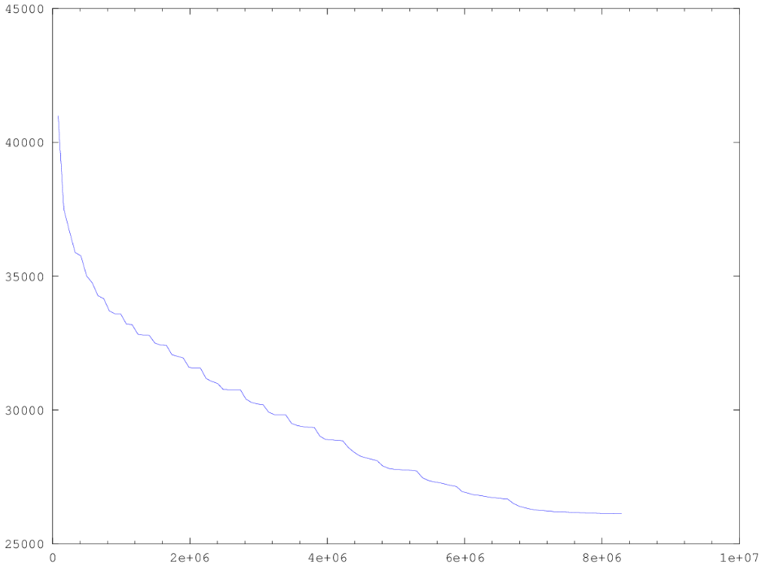
How does this Simple Placer Work?
It works ok …
Small benchmark
~2500 gates + ~500 pins
Placed in a 50x50 grid
Graph shows progress
Y axis: L = ∑_{nets Ni} HPWL(Ni)
X axis: # swaps
Yes, this ran for 8M swaps until progress on L stopped
L = ∑_{nets Ni} HPWL(Ni)
# random gate swaps→

Slide 29
Takeaways for the Simple Placer
Easy to understand and to implement
Start with a random placement and randomly improve the wirelength until it stops getting better
Can optimize what we care about: estimated wirelength ∑_{nets Ni} HPWL(Ni)
It will improve at each iteration always
However, the final result is still not very good
We are being too greedy to go out of the local optimal
We can do better for sure

Slide 30
Problem of the Simple Placer?
Imagine you could plot ∑HPWL for all possible placements
Our random method only takes swaps that improve wirelength
Can only find good results downhill from our random start
Easy to get stuck in a local minimum
∑HPWL
(lower is better)
If there are better answers, how to find?
All possible placement solutions we could find

Slide 31
Downhill and Uphill Movement
If we could go uphill, we may get better placements
How to control this?
∑HPWL
(lower is better)
All possible placement solutions we could find

Slide 32
Simulated Annealing (SA)-based Placer
Annealing temperature cooling “outer loop”
Start with a random initial placement with wirelength = ∑HPWL(net)
T = temperature = hot; frozen = false;
while ( ! frozen ) {
for (s=1; s< M* #gates in layout; s++) { // M is how many swaps-per-gate
Swap 2 random gates Gi and Gj
Compute ∆L = [∑HPWL(net) before swap] - [∑HPWL(net) after swap]
if (∆L < 0 )
then accept this swap //this is a new, better placement
else {
if( uniform_random() < exp( -∆L/T ) )
then accept this ‘uphill’ swap //this is a new, worse placement
else undo this ‘uphill’ swap
}
if (∑HPWL(net) still decreasing over the last few temperatures)
then T = 0.9 * T // cool the temperature; do more gate swaps
else frozen = true
}
return (final placement as best solution)
New: Probabilistic swap accept

Slide 33
Neighboring Solutions
.
M1: Displace a module to a new location
.
M2: Swap two gates
M3: Change the orientation of a macro, if any
1 2
2 1
Axis of reflections
1 2
3 4
3 4
3 4

Slide 34
Move Selection Strategy
Select a move between M1 and M2
Prob(M1)=4/5
Prob(M2)=1/5
If a move of type M1 is chosen and is rejected
Take a move of type M3 (for the same gate) with probability 1/10
Restriction on
How far a module can be displaced
What pairs of modules can be interchanged
M1: Displacement
M2: Interchange
M3: Reflection

Slide 35
Move Restriction
Range Limiter
At the beginning, R is very large, big enough to contain the whole chip
Window size shrinks slowly as the temperature decreases. In fact, height and width of R ∝ log(T)
Switching move begins when window size are so small that no inter-row modules interchange is permitted
Rectangular window R

Slide 36
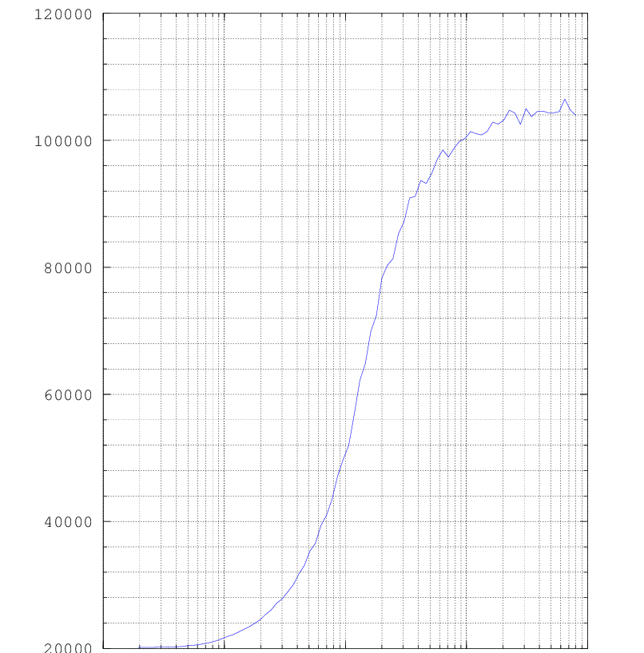
How does an SA-based Placer Work?
It works better
Same 2500 gate benchmark
HOT=800, M=100 moves/gate
About 30% less HPWL wirelength compared to the simple placer
Typical annealing “cost” curve
X axis is T=temperature, LOG scale
Do 100x2500 swaps/temperature
Read right-to-left
Y axis is ∑HPWL, but LOG scale
Cool fact: curves always look like this!
120K
∑HPWL
100K
80K
60K
← Placer progress
40K
T→
20K
0.1
1
10
100
1000

Slide 37
Problem of SA-based Placer
Simulated annealing is a very successful method
Much better than dumb random improvement
Dominant method for placers in 1980s, 1990s
And still today – used in lots of other VLSI CAD tasks (e.g., portioning, floorplanning, etc.)
However, this is not not how we really do placers today
Annealing works well for up to 100K – 500K gates
Annealing too inefficient for things with 1M+ gates
Today’s designs can easily have 500M+ gates
We need another new set of ideas

Slide 38
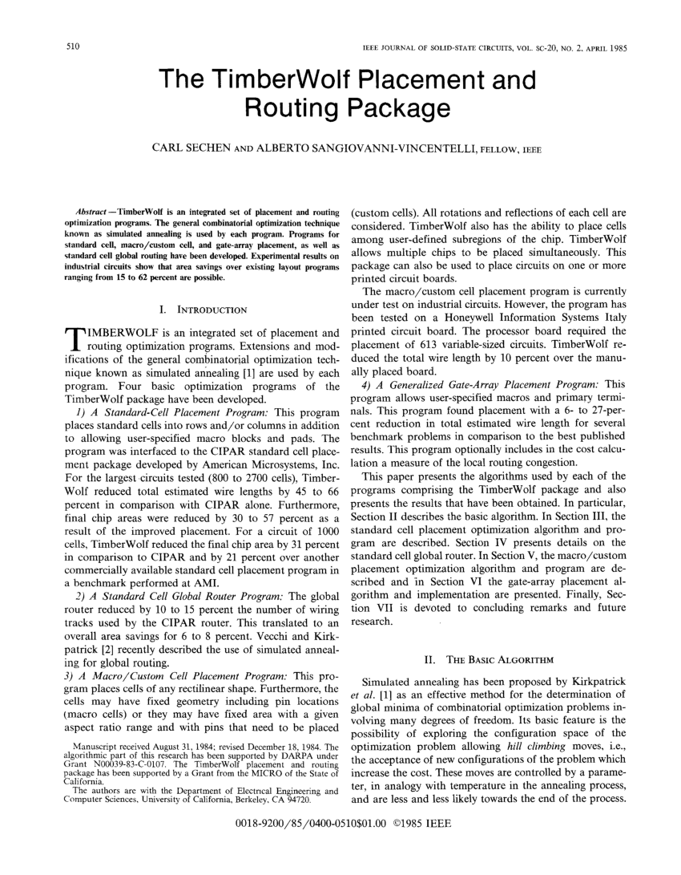

A Famous SA-based Placer: TimberWolf
http://www.twolf.com/
“The Timberwolf Placement and Routing Package”, Sechen, Sangiovanni; IEEE Journal of Solid-State Circuits, vol SC-20, No. 2(1985) 510-522

Slide 39
Summary
We have discussed basic ideas of placement
We have discussed importance and difficulty of placement
We have discussed the problem formulation of placement
Terminology
Input, output, objective
Wirelength estimation
We have discussed two simple placement solutions
Random iterative improvement-based placement algorithm
Simulated annealing-based placement

